Slide 1
Zomato Analysis
By Group 5
Ninad
Rashmi
Dhyan
Shabdajit
Shruti
Varsha

Slide 2

Agenda
6. GRATITUDE
1. COMPANY OVERVIEW
5. CHARTS & SUGGISTIONS
PROJECT
2. DATA MODEL
4. DASHBOARD
3. KPI’s

Slide 3




Company Overview
COMPANY
COUNTRIES
CITY
CUISINES
BOOKING PLATFORMS
Zomato is an Indian multinational platform that provides food delivery, restaurant discovery, and dining services. It connects customers, restaurants, and delivery partners across multiple countries through its app and website.
Australia
India
Canada
Sri Lanka
South Africa
Brazil
Noida Jaipur
New Delhi Mumbai
North Indian
Fast food
Café
Italian
Online delivery
Table booking

Slide 4
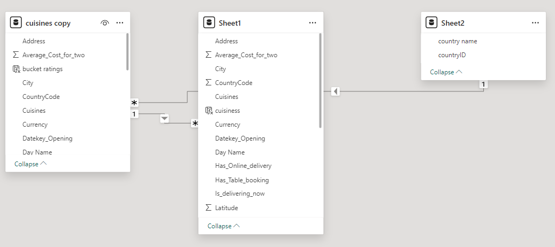
Data Model

Slide 5




Key Performance Indicators
KPI

Slide 6
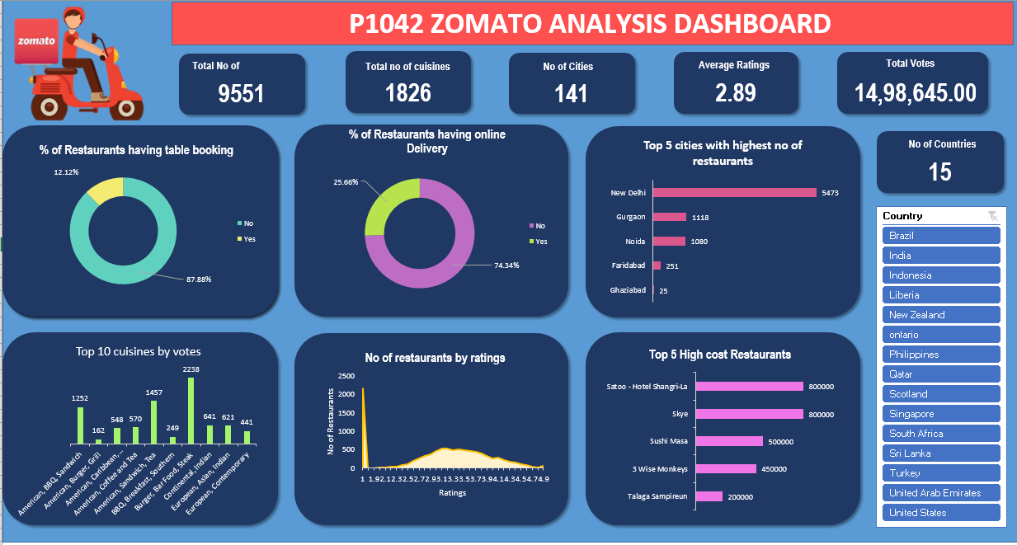
EXCEL dashboard

Slide 7
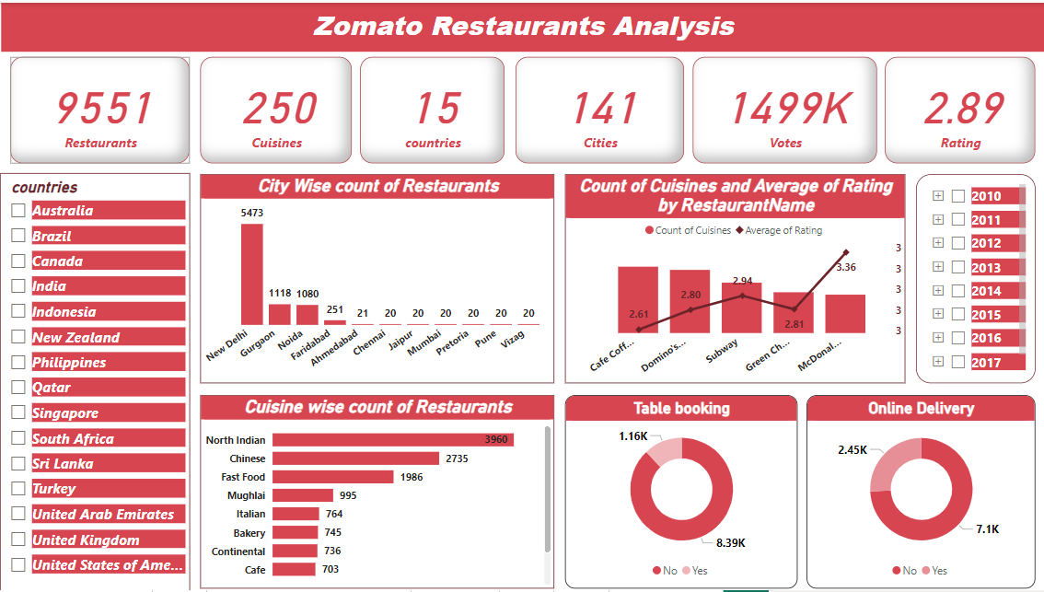
Power Bi
Dashboard

Slide 8
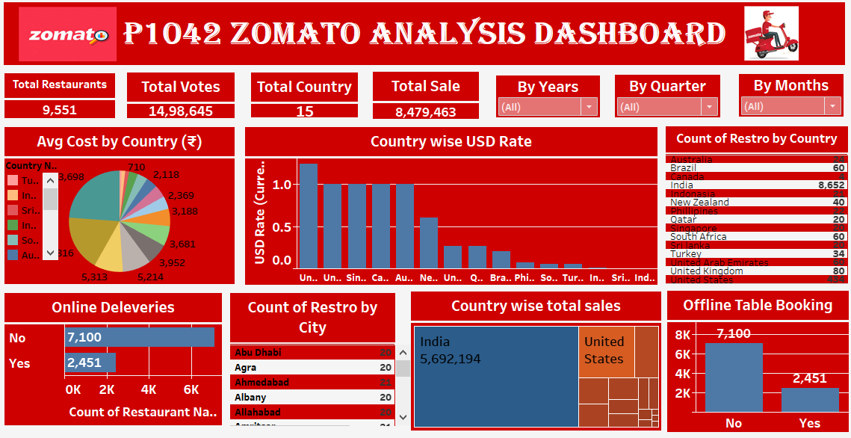
Tableau
Dashboard

Slide 9
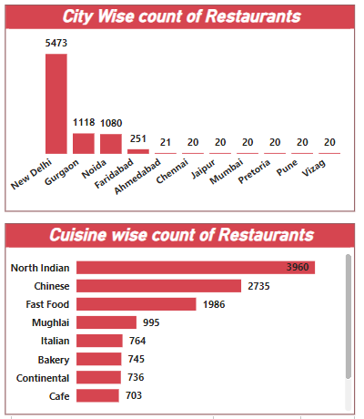
Chart and Suggestions
Focus on Market Expansion:
New Delhi dominates with over 50% of restaurants — explore expansion in underrepresented cities like Pune, Vizag, and Chennai to balance market presence.
Cuisine Diversification:
North Indian and Chinese cuisines lead the listings. Introducing or promoting niche cuisines (e.g., continental or regional specialties) could attract new customer segments.
Boost Table Booking Adoption:
Only ~12% of restaurants offer table booking. Increasing partnerships with restaurants for reservations can enhance user convenience and loyalty.
Enhance Online Delivery Reach:
About 77% of restaurants provide online delivery — aim for 90%+ by onboarding smaller eateries, especially in Tier-2 cities, to capture growing delivery demand.
Improve Customer Ratings:
The overall average rating (2.89) is relatively low. Focus on quality control, customer feedback, and top-rated restaurant promotion to uplift the platform’s reputation.

Slide 10
Thank You

